Slide 1
Investigation in DC crime trend 2016-2021
Xuanyu Chen
Yuchuan Feng
Ore Asaba
Kentaro Osawa
Adewale Maye
December 12, 2022
Notes:
To do analysis of DC crimes, we need to find the data sources in the following website.

Slide 2
SMART QUESTION
Is there a difference in trends of several crime categories among white males between 2016-2021, grouped into Pre and Post Covid periods?

Slide 3
Midterm Project Overview
Used the data provided by the Metropolitan Police of DC regarding adult arrests over a time period stretching between 2016-2021
Focused on crimes committed by white males
Divided the data into “Pre-COVID” and “Post-COVID”, and estimated CIs for some major crimes
There are significant decreases in “Simple Assault”, “Traffic Violations”, and “Theft” after COVID-19

Slide 4
Final Project Objective
We did not consider the impact of differences in districts or days of the week on crime in the midterm project.
→ Examine the impact of differences in districts and days of the week on the number of several major crimes, both pre- and post-COVID

Slide 5

Log-linear model
Most variables in our data are categorical variable
→ Use Log-linear models
Log-linear model
Assumption:
$nij$ ~ Poisson($μij$)
Formula:
$\log\left(μij\right)= λ+ λi+λj+λij$
Two-way table
 |  | B
 |  | 1 | 2 | 3
A | 1 | n₁₁ | n₁₂ | n₁₃
 | 2 | n₂₁ | n₂₂ | n₂₃
A
B
AB

Slide 6
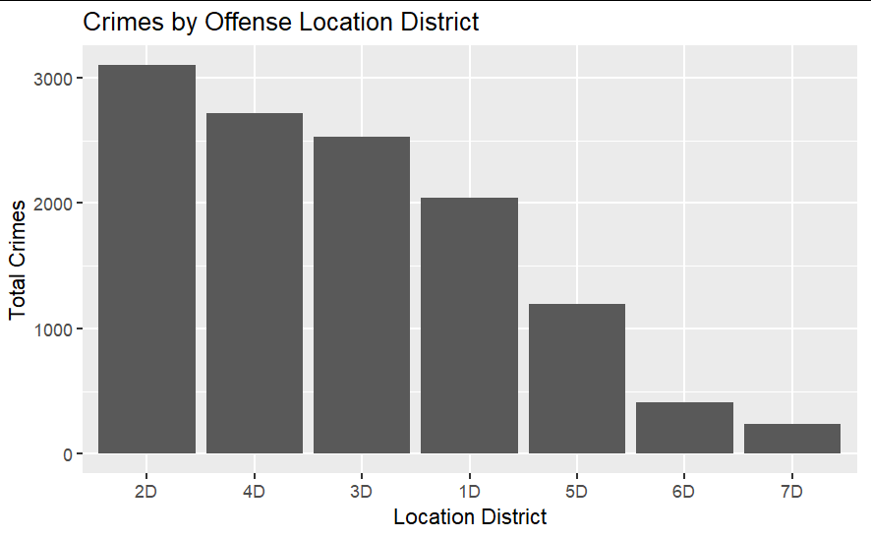
Our Data
Our data has many categorical variable
ex) District: 1D ~ 7D
Weekday: Mon ~ Sun
If the classification is too detailed, individual cell counts will be low, making modeling difficult
→ Focus on 1D ~ 5D
Classify weekend = 0 (Mon ~ Fri) and 1 (Sat ~ Sun)
small

Slide 7
Two-way tables
Simple Assault
Traffic violations
Theft
 | 0 | 1
1D | 154 | 111
2D | 286 | 250
3D | 255 | 227
4D | 301 | 195
5D | 100 | 43
 | 0 | 1
1D | 44 | 31
2D | 111 | 67
3D | 96 | 51
4D | 103 | 78
5D | 32 | 22
 | 0 | 1
1D | 103 | 39
2D | 244 | 101
3D | 144 | 66
4D | 229 | 118
5D | 130 | 52
 | 0 | 1
1D | 10 | 7
2D | 73 | 27
3D | 18 | 9
4D | 35 | 4
5D | 9 | 3
 | 0 | 1
1D | 55 | 25
2D | 126 | 43
3D | 118 | 37
4D | 70 | 22
5D | 63 | 25
 | 0 | 1
1D | 7 | 1
2D | 14 | 8
3D | 15 | 2
4D | 6 | 2
5D | 18 | 11
Pre-COVID
Post-COVID
Pre-COVID
Post-COVID
Pre-COVID
Post-COVID

Slide 8

Methods
Create 5 models:
Model 1: $\log\left(μij\right)= λ$
Model 2: $\log\left(μij\right)= λ+ λi$
Model 3: $\log\left(μij\right)= λ+ λj$
Model 4: $\log\left(μij\right)= λ+ λi+λj$
Model 5: $\log\left(μij\right)= λ+ λi+λj+λij$
Evaluate the models using Deviance, AIC, and BIC
A
B
A
B
A
B
AB

Slide 9
Results: Simple Assault (1)
Test the following hypothesis using deviance
H₀ : Reduced model is true
H₁ : Saturated model (Model 5) is true
Pre-COVID
Post-COVID
Model | Deviance | df | P-value
1 | 404.7 | 9 | < 0.0001
2 | 57.2 | 5 | < 0.0001
3 | 366.6 | 8 | < 0.0001
4 | 19.2 | 4 | 0.0007
Model | Deviance | df | P-value
1 | 152.7 | 9 | < 0.0001
2 | 32.6 | 5 | < 0.0001
3 | 122.9 | 8 | < 0.0001
4 | 2.8 | 4 | 0.59
H₀ is rejected for all models
H₀ is not rejected for Model 4

Slide 10
Results: Simple Assault (2)
Pre-COVID
Post-COVID
Model | AIC | BIC
1 | 476.3 | 476.6
2 | 136.9 | 138.4
3 | 440.2 | 440.8
4 | 100.8 | 102.6
5 | 89.6 | 92.7
Model | AIC | BIC
1 | 213.2 | 213.5
2 | 101.2 | 102.7
3 | 185.5 | 186.1
4 | 73.4 | 75.2
5 | 78.6 | 81.6
Model 5 is the best
Model 4 is the best

Slide 11
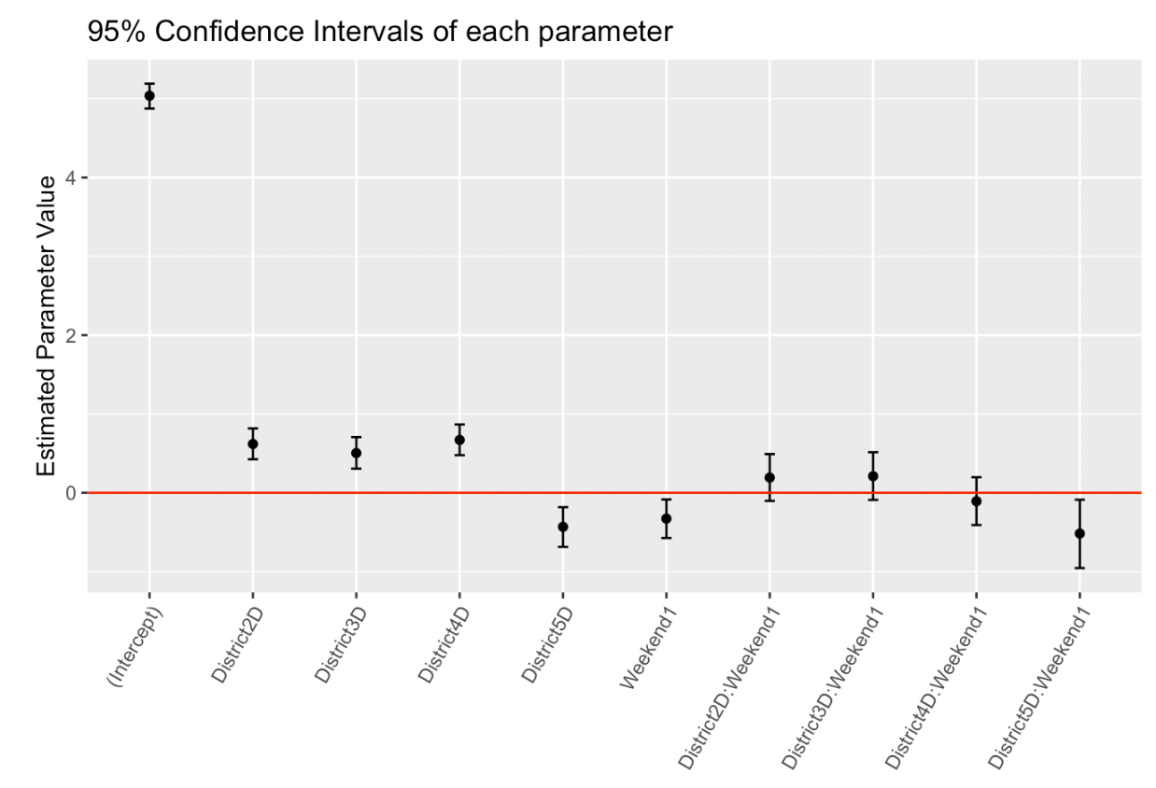
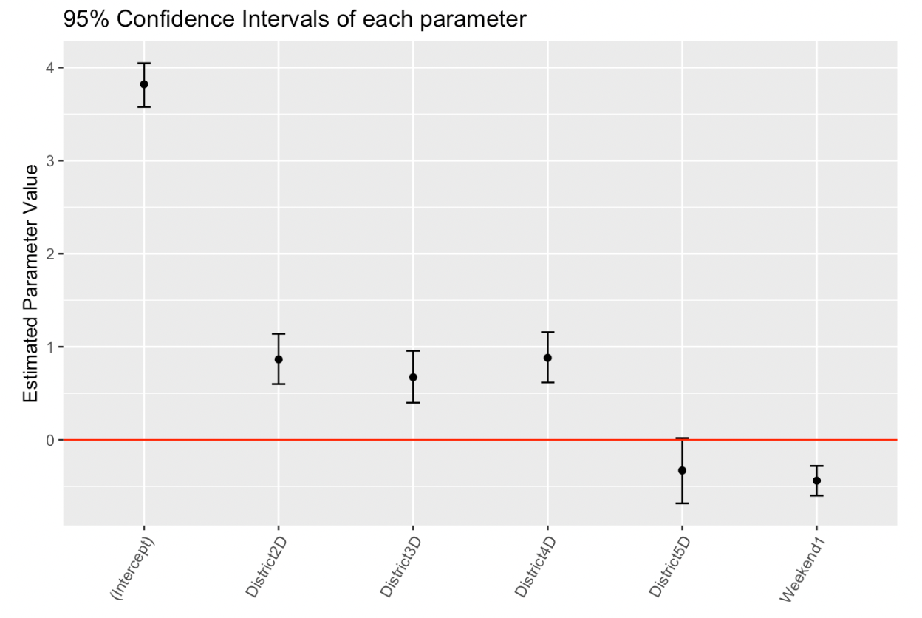
Results: Simple Assault (3)
Best model: Model 5 for pre-COVID, Model 4 for post-COVID
Interaction between 5D and weekend is negative
→ Because more people go to the other district on weekends?
Pre-COVID
Post-COVID

Slide 12
Results: Traffic Violations (1)
Test the following hypothesis using deviance
H₀ : Reduced model is true
H₁ : Saturated model (Model 5) is true
Pre-COVID
Post-COVID
Model | Deviance | df | P-value
1 | 339.3 | 9 | < 0.0001
2 | 191.4 | 5 | < 0.0001
3 | 151.1 | 8 | < 0.0001
4 | 3.2 | 4 | 0.52
Model | Deviance | df | P-value
1 | 168.9 | 9 | < 0.0001
2 | 57.0 | 5 | < 0.0001
3 | 120.6 | 8 | < 0.0001
4 | 8.7 | 4 | 0.07
H₀ is not rejected for Model 4
H₀ is not rejected for Model 4

Slide 13
Results: Traffic Violations (2)
Pre-COVID
Post-COVID
Model | AIC | BIC
1 | 406.2 | 406.5
2 | 266.4 | 267.9
3 | 220.1 | 220.7
4 | 80.2 | 82.0
5 | 85.0 | 88.0
Model | AIC | BIC
1 | 214.7 | 215.0
2 | 110.7 | 112.2
3 | 168.3 | 169.0
4 | 64.4 | 66.2
5 | 63.7 | 66.8
Model 4 is the best
Model 4 is the best from BIC
“BIC is more useful in selecting a correct model while the AIC is more appropriate in finding the best model for predicting future observations.” (Chakrabarti & Ghosh (2011))

Slide 14
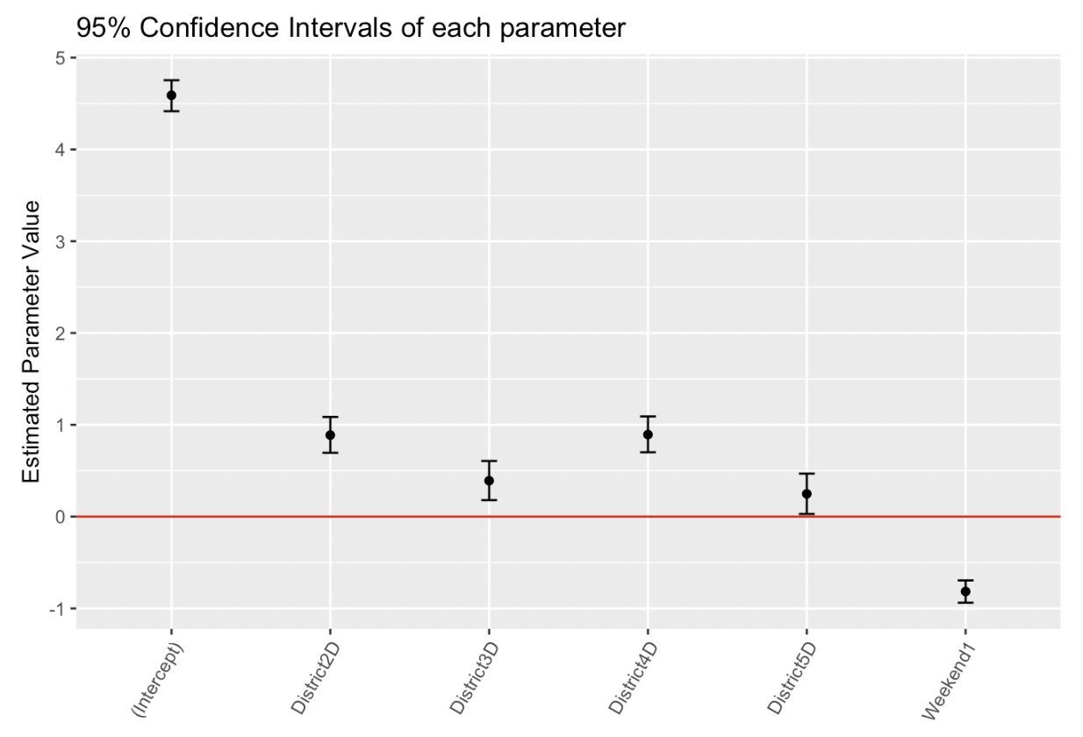
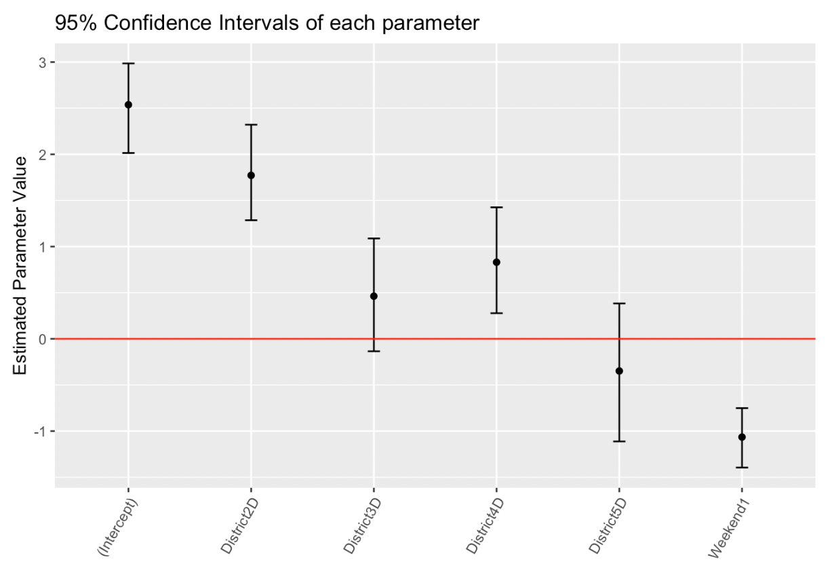
Results: Traffic Violations (3)
Best model: Model 4 for pre-COVID and post-COVID
2D parameter is large compared to other districts after COVID outbreak
→ Traffic volumes in 2D were not well decreased after COVID?
Pre-COVID
Post-COVID

Slide 15
Results: Theft (1)
Test the following hypothesis using deviance
H₀ : Reduced model is true
H₁ : Saturated model (Model 5) is true
Pre-COVID
Post-COVID
Model | Deviance | df | P-value
1 | 200.2 | 9 | < 0.0001
2 | 141.9 | 5 | < 0.0001
3 | 60.3 | 8 | < 0.0001
4 | 2.0 | 4 | 0.74
Model | Deviance | df | P-value
1 | 42.0 | 9 | < 0.0001
2 | 21.8 | 5 | < 0.0001
3 | 26.0 | 8 | < 0.0001
4 | 5.8 | 4 | 0.21
H₀ is not rejected for Model 4
H₀ is not rejected for Model 4

Slide 16
Results: Theft (2)
Pre-COVID
Post-COVID
Model | AIC | BIC
1 | 259.5 | 259.8
2 | 209.2 | 210.7
3 | 121.6 | 122.2
4 | 71.3 | 73.1
5 | 77.3 | 80.4
Model | AIC | BIC
1 | 80.6 | 80.9
2 | 68.4 | 69.9
3 | 66.7 | 67.3
4 | 54.5 | 56.3
5 | 56.7 | 59.7
Model 4 is the best
Model 4 is the best

Slide 17
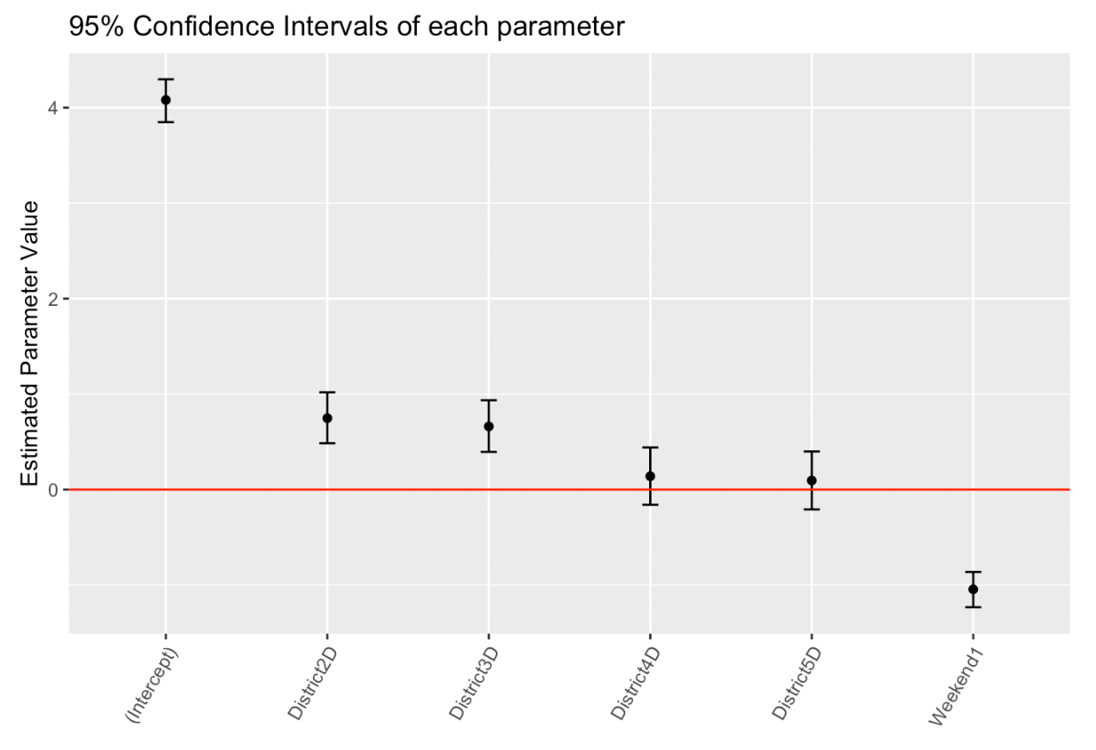
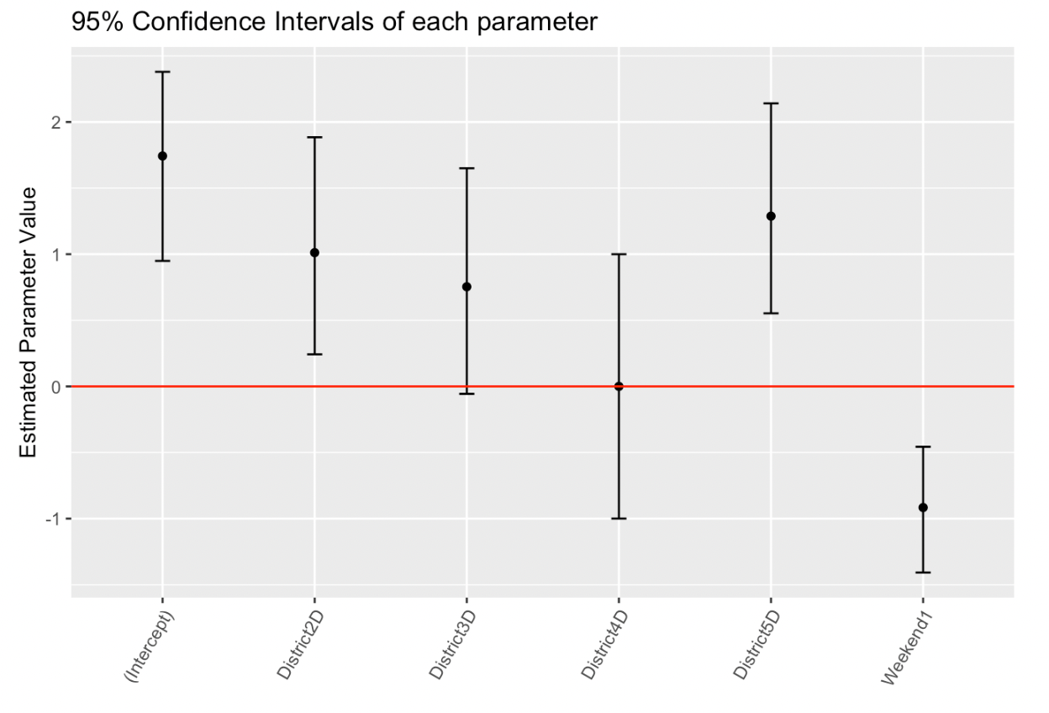
Results: Theft (3)
Best model: Model 4 for pre-COVID and post-COVID
5D parameter is small before COVID-19 but large compared to other districts after COVID-19
Post-COVID
Pre-COVID

Slide 18
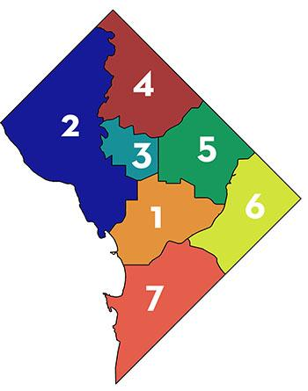
Conclusion
SMART QUESTION:
Is there a difference in trends of several crime categories among white males between 2016-2021, grouped into Pre and Post Covid periods?
ANSWER:
COVID-19 appears to not only reduce the number of crimes, but also change crime trends. In particular, 5D (large part of the Northeast region) seems to have changed crime trends compared to other districts.
https://mpdc.dc.gov/sites/default/files/dc/sites/mpdc/publication/attachments/Citywide%20Map%2024x24.pdf

Slide 19
References
Chakrabarti, A., & Ghosh, J. K. (2011). AIC, BIC and recent advances in model selection. Philosophy of statistics, 583-605.

Slide 20

Thank you!

Slide 21
Question?

